Slide 1
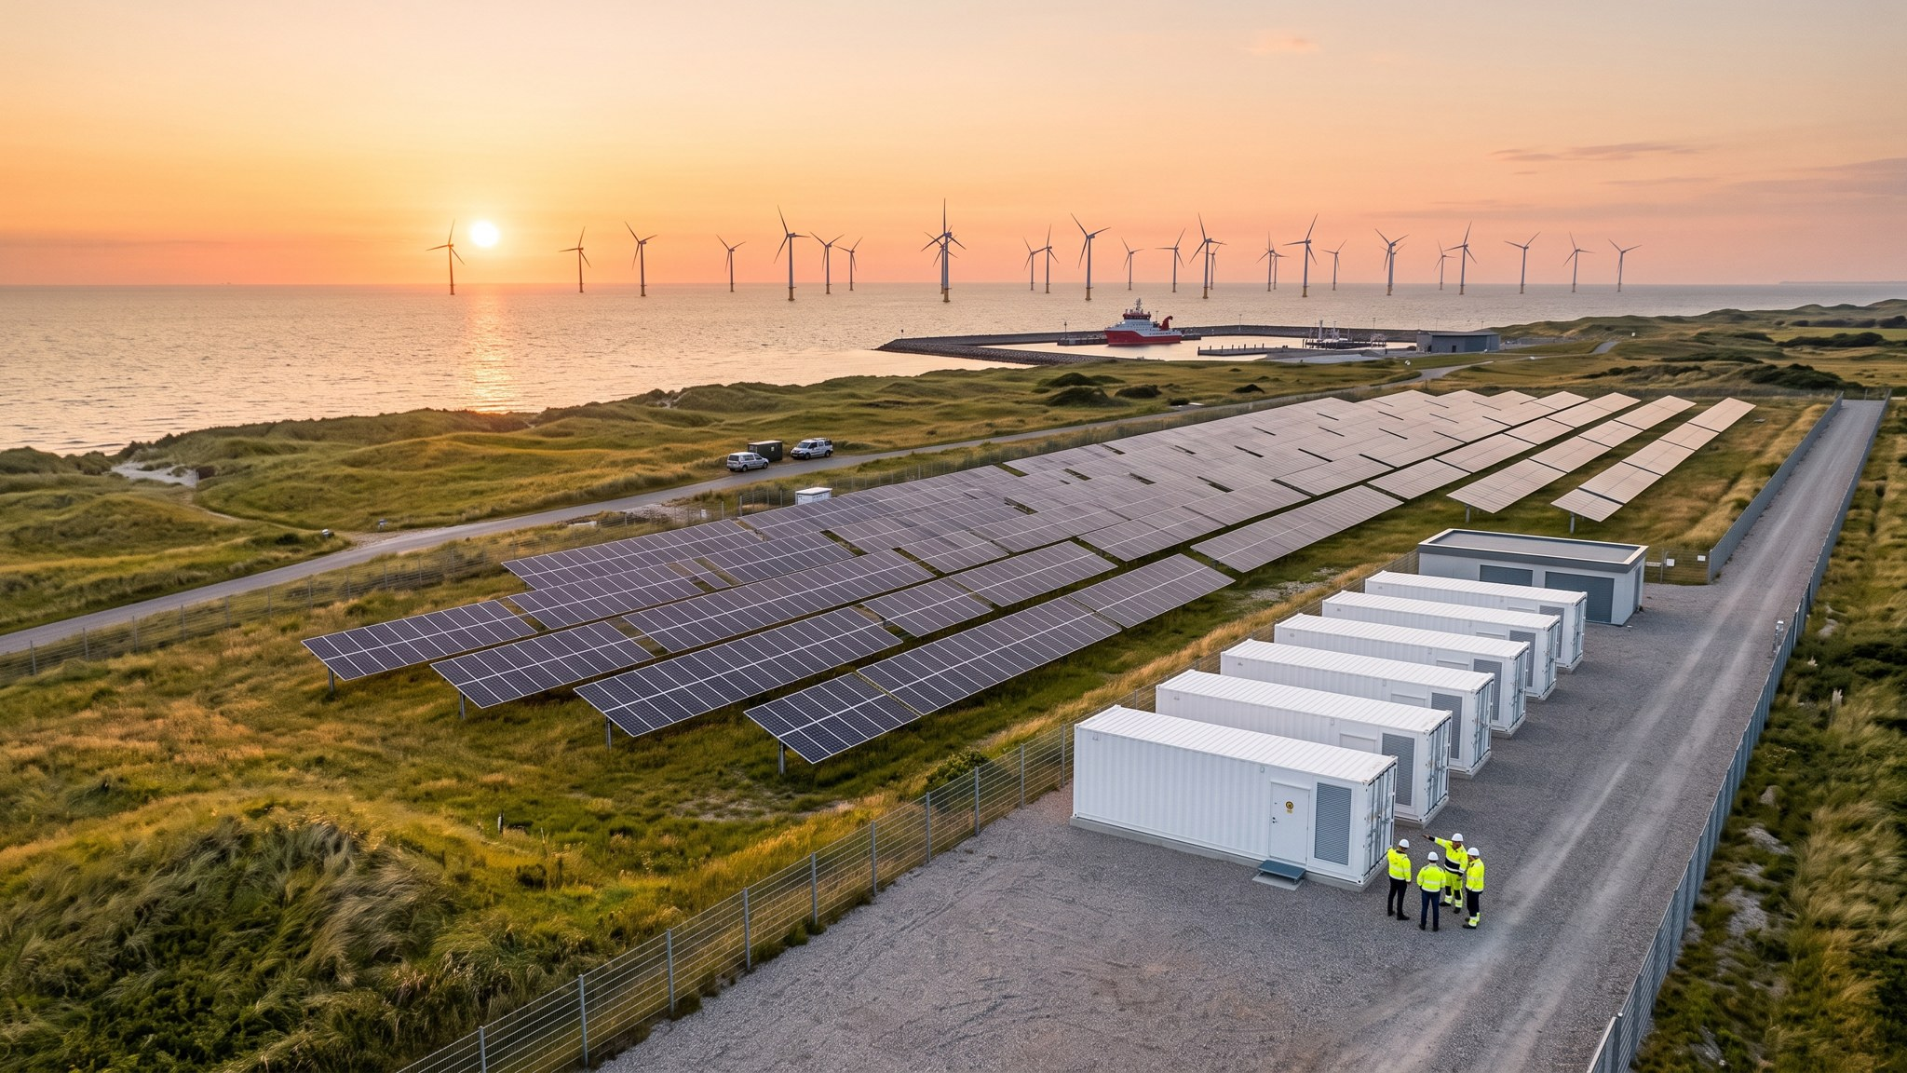
WEYLAND ENERGY
Strategy 2030
Clean power, built to last.

Slide 2
Where we stand today
1.1 GW
EUR 312 m
EUR 148 m
1.2 Mt
operating capacity
revenue 2025
EBITDA 2025
CO₂ avoided 2025
• 450 people in Hamburg, Edinburgh and Copenhagen
• Harrow Bay (480 MW) heading for FID
WEYLAND ENERGY · Strategy 2030 – Clean power, built to last
2

Slide 3
Our ambition for 2030
2.5 GW
EUR 600 m
≥ 45 %
4.2 GW
operating capacity
revenue
EBITDA margin
pipeline
WEYLAND ENERGY · Strategy 2030 – Clean power, built to last
3
Notes:
Ambition approved on 19 March 2026. Revenue target assumes P50 and the price deck of January 2026.

Slide 4
Three growth pillars
Offshore wind · Solar & storage · Flexibility & hydrogen

Slide 5
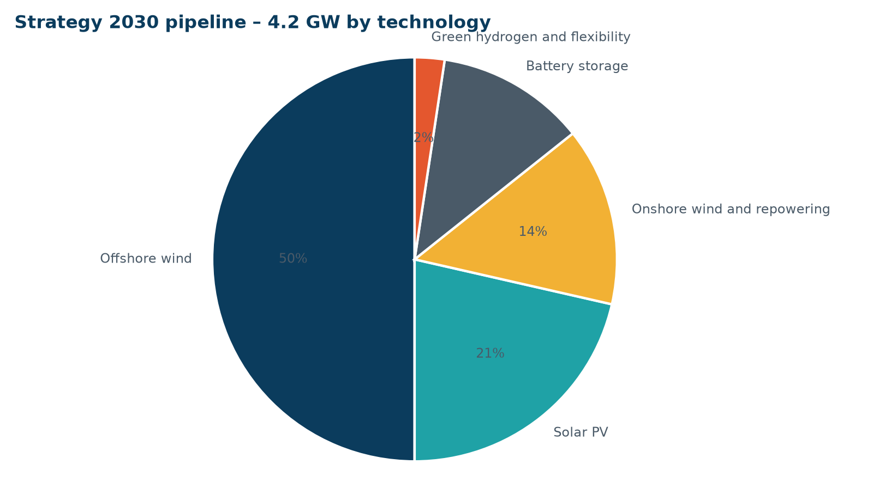
Pipeline of 4.2 GW
• Offshore wind: 2.1 GW – Harrow Bay (0.48 GW, in construction) and two North Sea follow-on sites
• Solar PV: 0.9 GW – Millbrook 85 MWp plus 11 sites in England, Denmark and northern Germany
• Onshore wind and repowering: 0.6 GW – Repowering of German onshore fleet, Scottish extensions
• Battery storage: 0.5 GW – Fenwick 100 MW / 200 MWh and co-located BESS
• Green hydrogen and flexibility: 0.1 GW – 5 MW Port of Eastholm pilot, scale-up option with Arcturus Steel
WEYLAND ENERGY · Strategy 2030 – Clean power, built to last
5

Slide 6
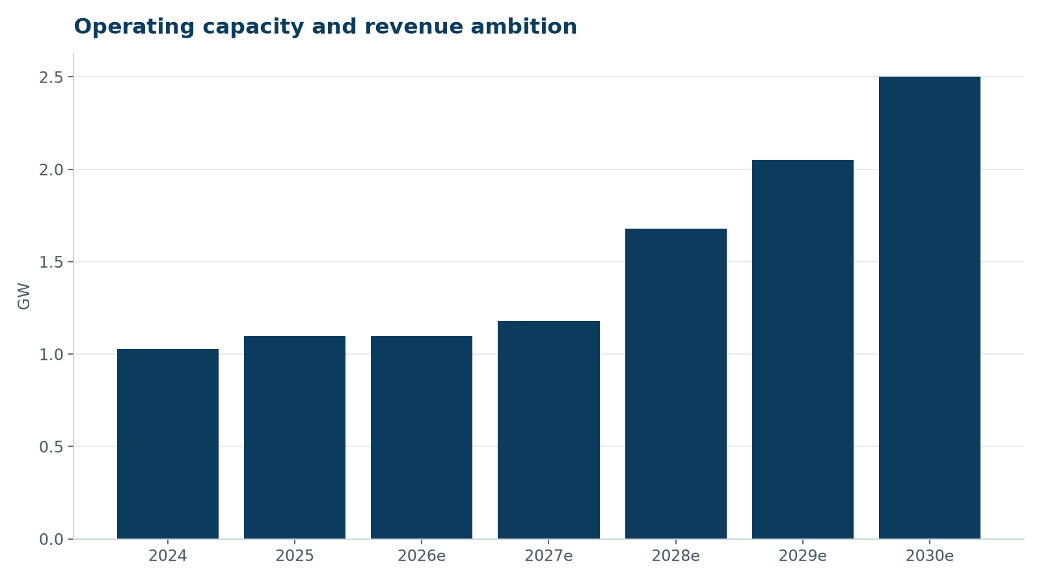
Growth path
• Harrow Bay COD mid-2028 adds 480 MW
• Millbrook and Fenwick from 2028/29
• Repowering and follow-on offshore sites by 2030
WEYLAND ENERGY · Strategy 2030 – Clean power, built to last
6

Slide 7
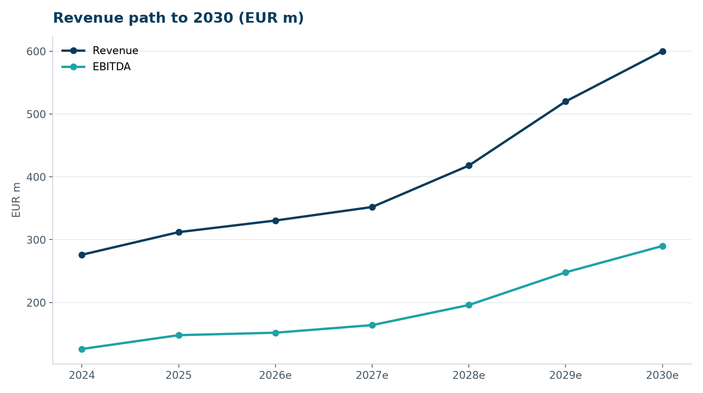
Financial ambition
• Revenue doubling to EUR 600 m
• EBITDA margin ≥ 45 %
• Capital recycling of up to EUR 400 m by 2028
• Net debt / EBITDA ≤ 6.0x after COD
WEYLAND ENERGY · Strategy 2030 – Clean power, built to last
7

Slide 8
Enablers
• Safety first – TRIR below 2.0 by 2028
• People – grow to around 620 employees, leadership programme
• Digital – one data platform for the fleet, ISO 27001 by Q2 2027
• Communities – benefit funds at every new site
• Partnerships – long-term PPAs with industrial offtakers
WEYLAND ENERGY · Strategy 2030 – Clean power, built to last
8

Slide 9
Roadmap
Year | Milestones
2026 | Harrow Bay FID and construction; Millbrook planning application; PPA with Arcturus Steel
2027 | Harrow Bay first power; Millbrook consent; Fenwick grid offer; ISO 27001
2028 | Harrow Bay COD; Millbrook and Fenwick construction; first capital recycling
2029 | Follow-on offshore site 1 FID; hydrogen scale-up decision
2030 | 2.5 GW in operation; EUR 600 m revenue
WEYLAND ENERGY · Strategy 2030 – Clean power, built to last
9

